Slide 1
IMPROVING COLLABORATIVE FILTERING THROUGH TOPIC DIVERSIFICATION
Lorenzo Proietti 1754547
Francesco Montano 1744183
Stefano Perrella 1755661

Slide 2
MOTIVATION
PROBLEM
SOLUTION
Collaborative filtering may tend to suggest items that are very similar to each other.
Introduce a metric to assess diversity of a recommendation list and an algorithm that diversifies a given list according to the same metric.

Slide 3
REFERENCE PAPER
Improving Recommendation Lists Through Topic Diversification: link.
They conducted two experiments:
an offline experiment: measure accuracy reduction derived from diversification,
an online experiment: measure user satisfaction derived from diversification.
ORIGINAL WORK
OUR WORK
We could only conduct the offline experiment because we didn’t have the possibility to reach the users present in our dataset.

Slide 4
THE OFFLINE EXPERIMENT
Implement a recommender system based on collaborative filtering (both user-based and item-based),
devise a similarity measure in order to assess diversity of returned ranked lists,
implement an algorithm that increases the diversity in a given ranked list.
THE TASK
increase in user satisfaction,
reduction in the overall DCG.
The satisfaction increment, though, could be detected only performing the online experiment; we show instead how the DGC value decreases as the list gets more diversified.
EXPECTED RESULTS

Slide 5
THE DATA
The authors of the paper used a dataset containing ratings (both implicit and explicit) about books, along with informations about each book.
We retrieved the same dataset from this website. At the same time, informations about topics of the books were missing and we managed to retrieve them from Amazon website through web scraping.
BOOKS
We downloaded an additional dataset from kaggle. This dataset contains ratings (explicit only) about movies, along with further informations about each movie.
This dataset is way bigger (approximately 26 millions of ratings) than the books’ dataset used by the authors (1 million ratings).
MOVIES

Slide 6
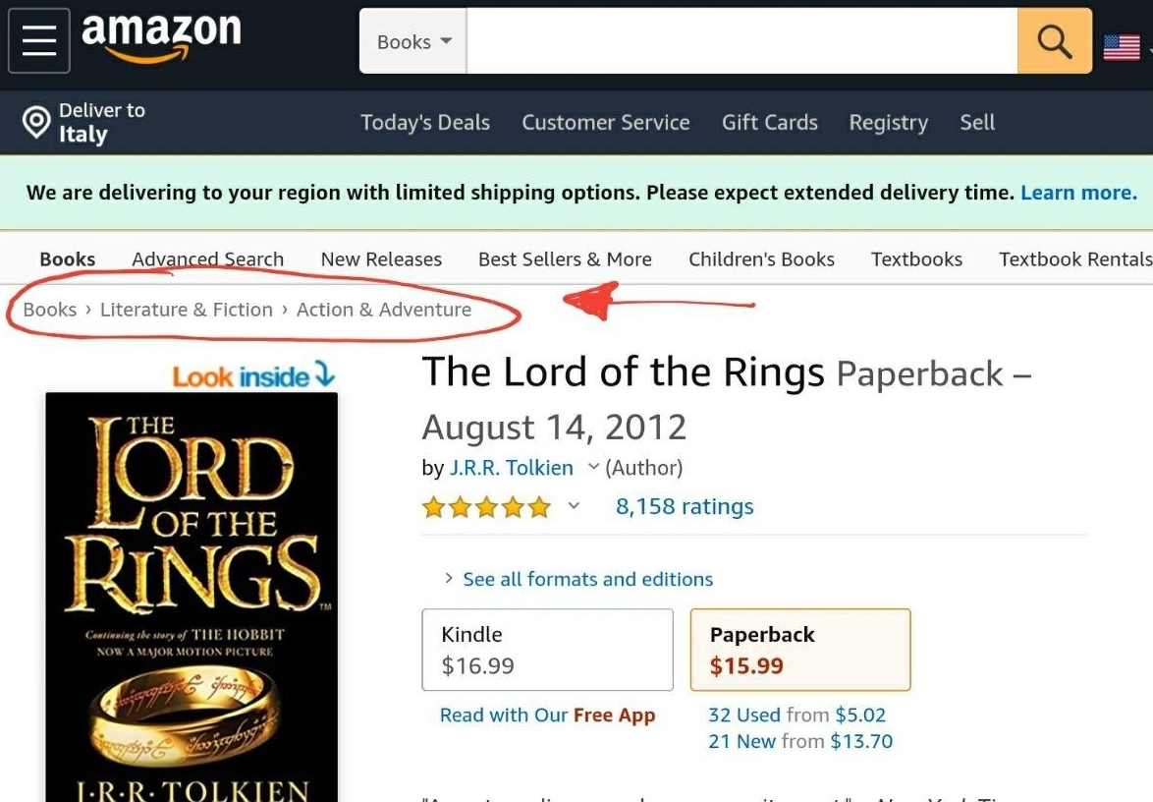

Slide 7
DATA PREPROCESSING
removed all books for which we couldn’t retrieve the topic on Amazon’s website,
removed all users that rated less than 5 books,
removed all books that had been rated by less than 20 users,
built an utility matrix as a python dictionary, in order to have a sparse representation.
BOOKS
removed all movies for which the dataset lacked further informations (like topic, author, ...),
removed all users that rated less than 25 movies,
removed all movies that had been rated by less than 25 users,
built an utility matrix as a python dictionary, in order to have a sparse representation.
MOVIES

Slide 8
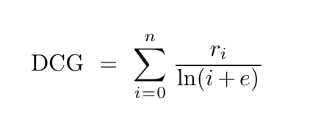
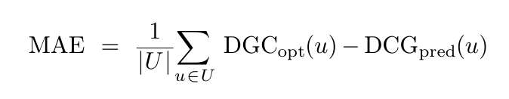
ERROR METRIC
Mean Absolute Error as difference between DCG of optimal ranking and returned one.
BOOKS
Mean Absolute Error as difference between DCG of optimal ranking and returned one.
MOVIES
Where r_{i} is the true rating of item i, DCG_{opt}(u) is the optimal discounted cumulative value of user u’s ranked recommendation list, DCG_{pred}(u) is the DCG of his/her predicted ranked list, U is the set of tested users. In MAE we didn’t have to insert the absolute value given that DCG_{opt}(u) is always bigger than DCG_{pred}(u).

Slide 9
SIMILARITY MEASURE
The authors used only topic information to compute the similarity measure; this means that two books are different or similar only in terms of their topics. We decided to introduce other elements in the computation of this metric, to obtain more accurate results.
The similarity measure between two books is a weighted sum of the single similarities in terms of
topic,
author.
BOOKS
The similarity measure between two movies is a weighted sum of the single similarities in terms of
genre,
production company,
production country,
original language.
Single similarities have been evaluated using Jaccard coefficient.
MOVIES

Slide 10
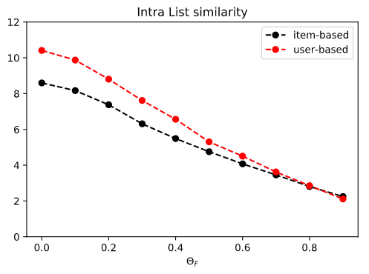
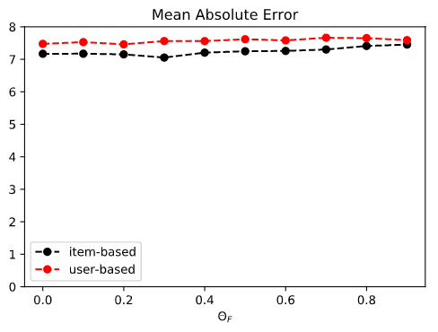
RESULTS - BOOKS
We run the diversification algorithm for different values of Θ_{F}∈[0,1]: this is called diversification factor; higher values of Θ_{F} denote higher levels of diversification.
Even if we expected an increasing mean absolute error, we found a different result: despite the diversification was indeed effective (we can see in the left graph how the intra-list similarity score decreases), the error did not increase probably because of the structure of the dataset: the ratings in this dataset tend to be really high and low variance, so that applying a diversification algorithm like the one presented in the paper is not enough to produce a substantial increase in the error of predictions. On the other hand, the effect of diversification is better observed with the second dataset.

Slide 11
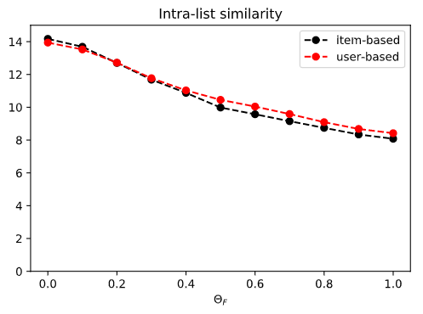
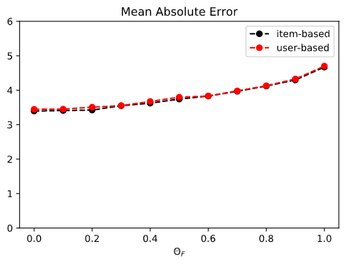
RESULTS - MOVIES
We run the diversification algorithm for different values of Θ_{F}∈[0,1]: this is called diversification factor; higher values of Θ_{F} denote higher levels of diversification.
The graph on the right shows how the mean absolute error increases as the diversification factor gets bigger: as expected, if the returned ranked list is fed as input to the diversification algorithm, it will become more different from the optimal ranked list. At the same time, we can see how the intra-list similarity measure decreases, since the elements of the resulting list will be more different amongst each other with respect to the original.

Slide 12
CONCLUSIONS
MAE stays almost constant after the application of diversification algorithm (actually it slightly increases) because the explicit ratings in the books’ dataset are not enough in number and they are not variant enough (the vast majority is very high)
BOOKS
Here instead, as expected, the MAE increases when the diversification factor is bigger. Even if the results obtained using explicit ratings should not be compared with those obtained from the authors using implicit ratings, we cannot help but notice that in our results item-based CB behaved exactly the same as user-based CB, without being more affected by topic diversification.
MOVIES

Slide 13
RELATED WORKS AND FUTURE PROJECTS
At the following webpage there is a study that we found to be very similar to the one we conducted: the authors tried to increase the surprise a user will experience when getting a recommendation from the recommender system; in particular, their differentiation algorithm is not applied to a ranked list, but to relevant topics themselves.
RELATED WORKS
In the future we would like to implement a recommender system that uses topic-diversification (and maybe even more diversification techniques) in an application project about a ‘sui generis’ mobile ecommerce we have been planning to develop for a couple of years.
FUTURE PROJECTS

Slide 14
REFERENCES
[1] Cai-Nicolas Ziegler, Sean M. McNee, Joseph A. Konstan, and Georg Lausen. 2005. Improving recommendation lists through topic diversification. In Proceedings of the 14th international conference on World Wide Web (WWW ’05). Association for Computing Machinery, New York, NY, USA, 22–32.
[2] A. Al-Doulat, "Surprise and Curiosity in A Recommender System," 2018 IEEE/ACS 15th International Conference on Computer Systems and Applications (AICCSA), Aqaba, 2018, pp. 1-2, doi: 10.1109/AICCSA.2018.8612897.

